Slide 1
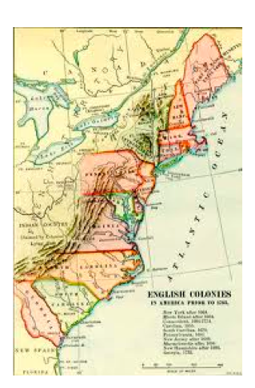
Chapter 6:
The United States Breaks Away

Slide 2
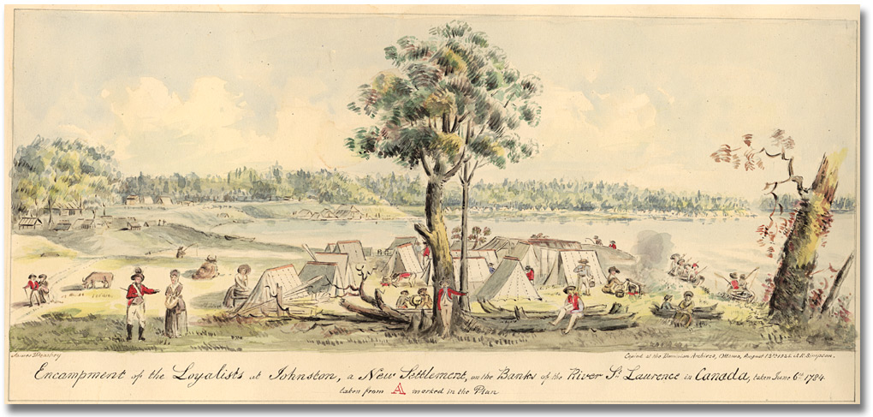
Targets for Anger
“ Loyalists, with their brats and wives,
Should flee to save their wretched lives.”

Slide 3
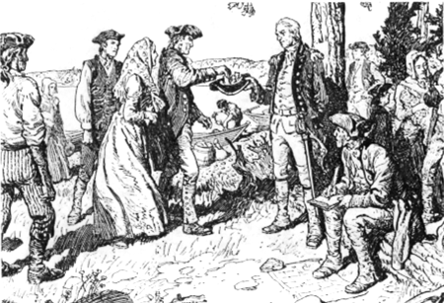
Targets for Anger
“A Loyalist is someone whose head is in England
Whose body is in America
And whose neck should be stretched.”

Slide 4
Targets for Anger
Quotes are about a group of people called the United Empire Loyalists

Slide 5
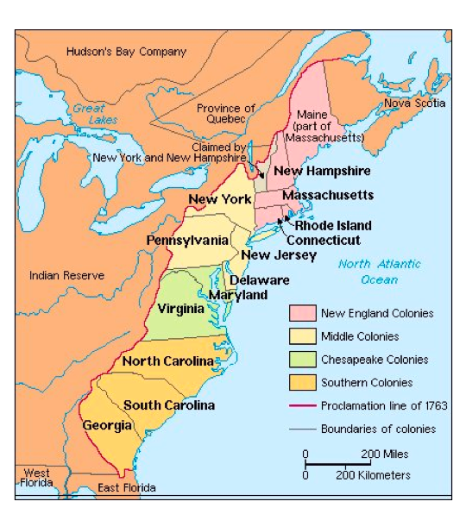

Slide 6
Conflict in 13 Colonies
1763 - Britain was deeply in debt (to owe money) after the Seven Years’ War and wanted to save $$
Wanted to keep troops stationed in 13 Colonies so decided to make 13 Colonies pay for troops
Britain raised taxes to do this (The Sugar Act 1764, The Stamp Act 1765, The Townshend Acts 1767, The Boston Massacre 1770, The Boston Tea Party 1773, The Coercive Acts 1774, The Quebec Act 1774, The First Continental Congress 1774)
Colonies refused to pay
13 Colonies said Britain didn’t have a right to do this, because colonist were not allowed to elect representatives to the British parliament
Slogan arose (protest): “No taxation without representation”

Slide 7
Discussion
Why do you think it was so important for the colonists to have input into their own governmental affairs?
What options did Britain have at this time? Do you think Britain should have given the Americans representation in their government?

Slide 8
Boston Massacre
Occurred on March 5th, 1770
The British had stationed “red coat” troops in many colonial towns to keep order. Colonists resented them.
One night, things got out of hand. About four hundred men had gathered in front of the Customs House where eight British sentries were standing guard. Patriots threw snowballs, rocks and ice and also teased and made fun of British.
British soldiers got really mad and someone shouted "Fire!“ Soldiers shot into the crowd.
Five patriots were killed.
Boston Massacre to make Colonists even angrier with the British. The Boston Massacre shows how things can get out of hand, especially when bad feelings already exist between people.

Slide 9
Boston Tea Party
Occurred on December 16th, 1773
In May 1773, Parliament gave money to the British East India Company so they could lower their tea prices. The Americans got mad because the British East India Company would trade only with pro-British merchants.
Three ships had come from England and wanted to dock in Boston Harbor.
Patriots disguised themselves as Natives Americans and threw all the tea into Boston Harbor as a political protest

Slide 10
Rebellion was in the air
1775 – protest turned into rebellion
Supports of the rebellion were called “Patriots”
Opposed to the rebellion were called “United Empire Loyalists”
On April 19, 1775, war broke out between the colonies and Great Britain and he American War of Independence or the American Revolution began!
The war lasted until 1783 (1775 - 1783 in total)

Slide 11
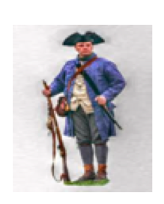
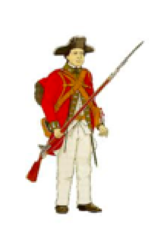
PATRIOT: people who supported the rebellion
UNITED EMPIRE LOYALISTS: people who opposed the rebellion - who wanted to remain united to the British Empire and loyal to Britain

Slide 12
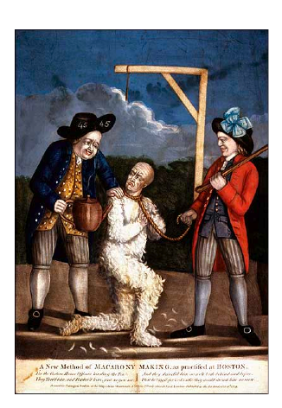
History Happens:
Tarring and Feathering on the Rise
P.173

Slide 13
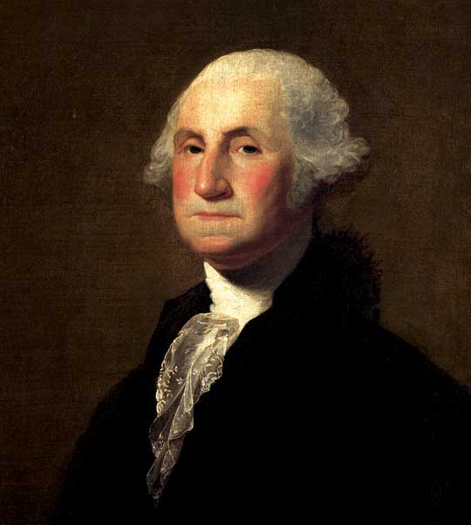
George Washington
George Washington took command of an army in the 13 Colonies to fight the British rule
George Washington would later became the first president of the U.S. in 1789

Slide 14
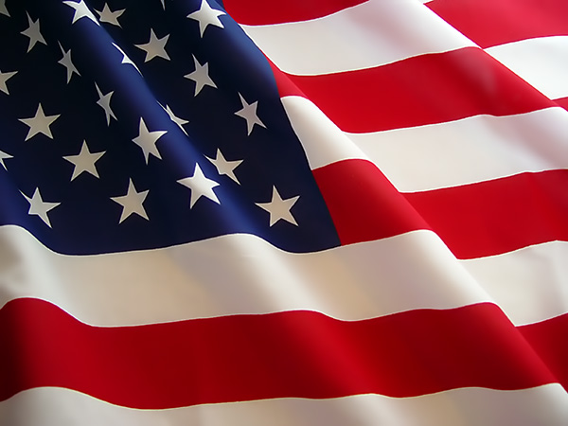
The Declaration of Independence
The Beginning of an American Identity

Slide 15
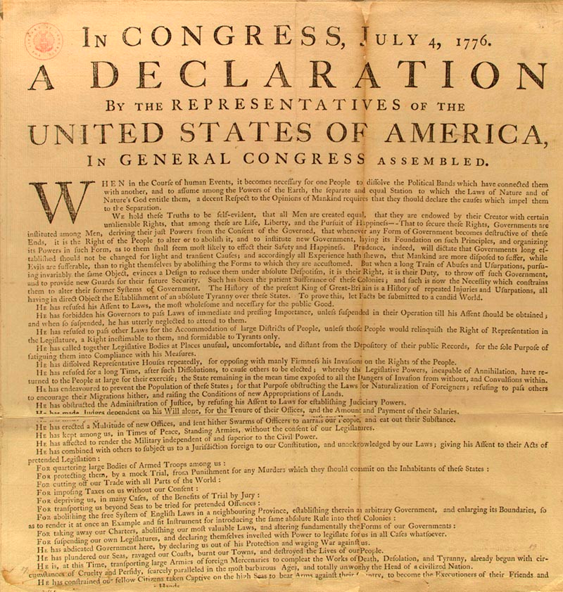

Slide 16
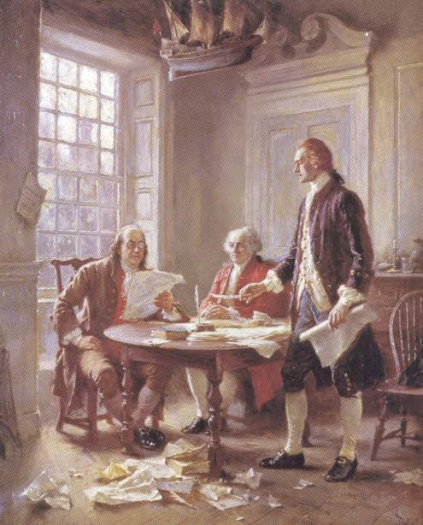
History
July 4th, 1776 > Now celebrated as Independence Day
Gave birth to United States
Some argue that it is the single most influential and most important document in American History
The original is on display at the National Archives and Records Building in Washington, DC

Slide 17
Drafting of the Declaration
June 11, 1776, the Continental Congress appointed a committee of five men to draft the Declaration: 1) John Adams 2) Benjamin Franklin 3) Thomas Jefferson 4) Robert Livingston 5) Roger Sherman
Jefferson was appointed to write the first draft.
Upon completion, the committee revised his draft and submitted it to the Continental Congress June 28th. The Congress voted for independence on July 2nd.
Once the final revisions were made, the Declaration of Independence was finally approved on July 4th.

Slide 18
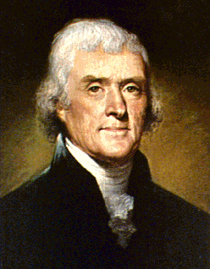
Thomas Jefferson (April 13th, 1743 - July 4th, 1826)
Political Offices:
He represented Virginia at the Continental Congress
Governor of Virginia from 1779-1781 during the American Revolution
U.S. Minister to France, 1785-89, in the years leading up to the French Revolution
Secretary of State under George Washington, 1790-93
Vice President under John Adams 1797-1801.
3rd President of the United States from 1801-1809
“Dissent is the highest form of patriotism.”
“All tyranny needs to gain a foothold is for people of good conscience to remain silent. ”

Slide 19
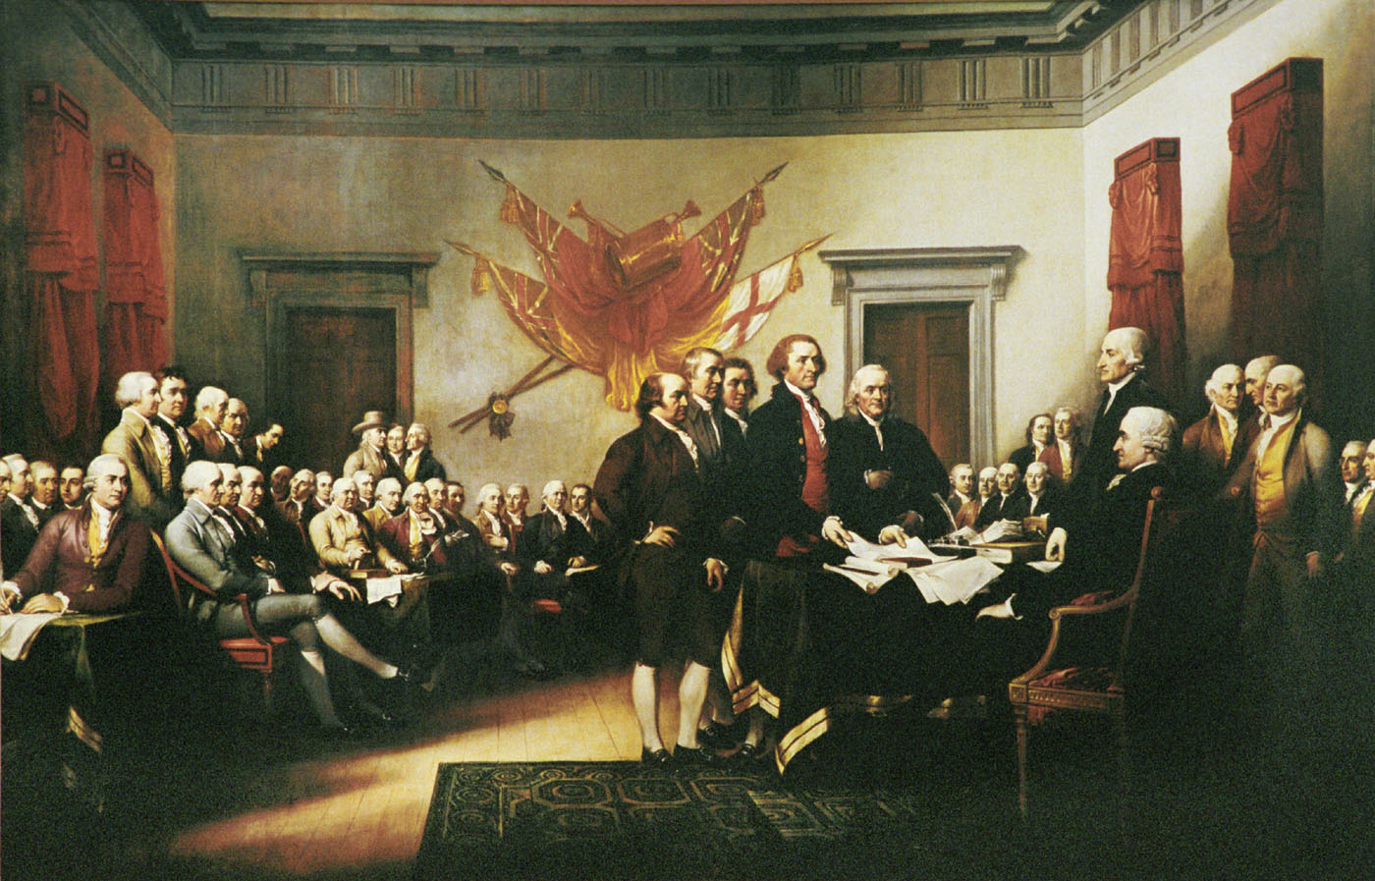

Slide 20
Reading of the Declaration of Independence
http://www.youtube.com/watch?NR=1&v=ETroXvRFoKY
Read by celebrities such as Mel Gibson, Michael Douglas, Whoopi Goldberg, Edward Norton, Winona Ryder, Renee Zellweger, Benicio Del Toro
Watch first 3 minutes

Slide 21
“Break Up” letter
Pretend you are America and you are breaking up with Britain in a letter.
Use specific historical data! Detail what Britain has done to you, what you don’t like about Britain’s actions and what you want to do differently without Britain. Be creative!
Before you begin writing, take the next 2 minutes to brainstorm ideas.
Alternate assignment: Write as if you are Britain and you are responding to America’s breakup letter.

Slide 22
The Battles of the American Revolution

Slide 23
Battle of Saratoga
September 19 and October 7, 1777
Saratoga is on the Hudson River in New York State
British (led by Burgoyne) had hoped that these battles would divide the colonies through the isolation of New England and that the British, through gaining control of the Hudson River, would break the American spirit and deter the French from coming to the aid of the Americans
However, the Battle of Freeman’s Farm caused a standoff between the Americans and the British, with Britain suffering twice the amount of casualties as the Americans. The standoff lasted over two weeks. This finally resulted in the Battle of Bemis Heights, which was an American victory and caused General Burgoyne to retreat to Saratoga.
The Americans surrounded Saratoga and forced the surrender of Burgoyne’s forces.

Slide 24
Why would the defeat of the British at Saratoga be so important to the outcome of the war?
It was a major turning point in the war because it led to an alliance between the United States and France. Holland and Spain also joined France. - France wanted to weaken Britain in Europe and had also hoped to regain some of the land it had lost in the Seven Years War - Spain joined in to protect and regain territory in America - Holland had trade grievances with Britain.
Benjamin Franklin had gone to France in 1777 to secure their formal recognition of the United States. The news of the British defeat at Saratoga was instrumental in obtaining French recognition.

Slide 25
Why was French support so important?
France’s intervention was crucial to the eventual American victory.
France had supplied the emerging nation with most of its money and munitions.
90% of the arms used by Americans at Saratoga were of French origin.
The help of the French Navy and of a French expeditionary force of 6,000 men enabled George Washington’s forces to win several victories.

Slide 26
Battle of Yorktown
Americans (led by George Washington) and the French (led by General Comte de Rochambeau) vs. British (led by General Lord Cornwallis)
Last major battle of the American Revolution
In September 1781, the French forces defeated the British Fleet that was supposed to relieve Cornwallis and through this, the French gained control of the sea. This trapped Cornwallis between American/French forces and the sea. It removed the possibility of Cornwallis escaping or British reinforcements coming in. The French navy had prevented the British from being resupplied and reinforced.

Slide 27
Battle of Yorktown
Cornwallis had control over Yorktown and Gloucester.
With Cornwallis contained in Yorktown, the American and French forces surrounded the British army with American on one side and French on the other (essentially forming a semi-circle around them)
Cornwallis was forced to surrender October 19th, 1781. However, he would not do it himself. He cited that he was ill and sent a deputy to formally surrender his army of 8,000 men.
There were about 4,000 American battle deaths during the War of Independence.

Slide 28
A Wave of Refugees
The Loyalist Migration
People were pressured to choose sides: break away from British rule, or remain under British rule?
During and after the war many people fled 13 Colonies to the British Colonies of Quebec and Nova Scotia
Most called themselves British descendant Loyalists, but included in this “wave of refugees” were 3,000 black Loyalists, 2,000 Haudenosaunee (allies to the British), 3,000 German Mennonites (remained neutral in the war)
Tarring and feathering (see article on page 173) was used as a punishment to those who were viewed as siding with the British

Slide 29
Meet the Loyalists
Read profiles on pages 175-178
Hannah Ingraham
David George
Thayendanegea
Hans Winger

Slide 30
Picturing Emergency Migrations
Handout

Slide 31
Build the Big Picture
P. 180
Migration: movement of people from one region of a territory to another

Slide 32
Arrival of the Loyalists: Cause and Effect
“A” caused “B” to happen
Because “B” happened, “C” happened
….and on and on it goes
Put the strips in chronological order
Some events might be happening simultaneously (adds extra challenge)

Slide 33
Challenges the Loyalists faced
Left all their possessions behind: had to start over
Faced exposure and starvation in some cases
Black Loyalists faced discrimination
Others who were part of the migration (Haudenosaunee and Mennonites – who were not called Loyalists because they had different motivations) also faced discrimination.
The Haudenosaunee had to demand land.
The Mennonites had to pay fines to the British government to exempt them from military service.

Slide 34
Impact of the Loyalists’ arrival on the French Canadiens
The arrival of the Loyalists changed the makeup of Quebec substantially as Quebec became more English.
The Loyalists were not content to live a French way of life in their new homeland and pressed the British government to make changes.
This concerned many Canadiens as they were afraid of losing their French language and Catholic religion

Slide 35
Impact of the Loyalists’ arrival on First Nations
Because the Loyalists were mostly farmers, they wanted land.
First Nations however, also needed that land, and had rights to it, as recognized by the Royal Proclamation of 1763.
This brought about a significant shift in British and First Nations’ relations, as the British now tried to negotiate the land away from First Nations’ control.

Slide 36
Loyalists Press for Changes: What did the Loyalists want? P. 184-185
In Nova Scotia
Many joined already existing settlements in Nova Scotia
They took over the land the Acadians once farmed
A large group established a settlement along the St. John’s River, now known as New Brunswick. They felt separate from the other colonist of Nova Scotia – because of geography and politics.
The St. John River settlers were mostly NEW colonist. They felt they had different needs and priorities then the older more established British settlements. St. John River Colonist petitioned (to ask for something in a formal way) Britain for their OWN colony, separate from Nova Scotia.

Slide 37
What did the Loyalists want?
In Quebec
In the late 1780’s Britain received many petitions from loyalists in Quebec asking them to allow them to use British laws and customs in place of French laws and customs.
Britain now had a problem – it owed something to the Loyalists who had fought with them against the Americans but they also wanted to secure the goodwill of the new Loyalists settlers, in case the Americans decided to attack what was left of British North America.
But Britain had already passed the Quebec Act in 1774 to secure the support of Canadiens living in its colonies.
How could Britain balance the demands of the Loyalists and the Canadiens?

Slide 38
How did Britain respond to the Loyalists concerns?
Britain divided Nova Scotia into several new colonies in 1784. It gave the St. John’s River settlers their own colony, New Brunswick. They also created the separate colonies of Cape Breton Island and St. John Island.
A few years later, Britain recognized Quebec by passing the CONSTITUTIONAL ACT in 1791. This act established British laws and institutions for Loyalists settlers west of Montreal.

Slide 39
CONSTITUTIONAL ACT 1791
Divided Quebec into UPPER and LOWER Canada
Established British and criminal law in UPPER Canada
In Lower Canada, the act continued with the arrangements under the Quebec Act of 1774 : British criminal law but French civil law
Guaranteed the Canadiens the rights to the Catholic church, set aside land for Protestant Churches
Established officials and a Legislative council appointed by Britain in EACH colony and an assembly elected by the COLONISTS. This now meant Upper and Lower Canada now had REPRESENTATIVE GOVERNMENT (citizens elect representatives to an assembly and the assembly speaks for the citizens – “represents” them)

Slide 40
North America - 1791
The map on page 186 of your textbook

Slide 41
Expressions of Patriotism
Patriotism: pride in your country
It is expressed in the flag, the national anthem (sung at every hockey game!), uniforms (Olympic or military), Heroes (Terry Fox)
Many view the War of 1812 as a unifying experience in Canadian History – a time when diversity became less important than fighting together.
However, the textbook does not really focus on the war itself, but rather how diverse groups of people views the war and the impact it had

Slide 42
The War of 1812 (p.188-197)
In 1812, the United States finally declared war on Britain and attempted to invade North America. Now, at this time the Americans were not nearly as strong as they are today but it was a very real possibility that the Americans could take over North America.
In 1789, the French violently dethroned their monarch and had a revolution in order to become a republic. This act made all the monarchs in Europe nervous because they feared losing their power.
Other Monarch ruled countries in Europe worried they may be overthrown too and so they went to war against the French republic

Slide 43
The War of 1812 - part 2
In 1812, the Napoleonic Wars triggered a conflict in North America
Britain shut down trade between France and the US. It blocked America ships from landing at French ports. The British Navy was also boarding ships to look for British deserters.
To retaliate (get revenge) the US declared war on British land (North America) because it was the nearest piece of British territory.
The Americans expected the BNA colonists to join in their fight against British rule, but surprisingly the colonists fought back.

Slide 44
History Happens: Presidential Mansion Set Ablaze!
P. 189
Terrorism or simply an act of war???

Slide 45
The War of 1812 - Crash Course US History (John Green)
http://www.youtube.com/watch?v=qMXqg2PKJZU

Slide 46
Taking Sides in the War of 1812
P. 191-193
American Perspective
Hoped that the colonists in BNA would not oppose their takeover plans
General William Hull (July 1812) gave a speech to the inhabitants of Canada to try and get them to side with the US
Canadien Perspective
Catholic church opposed uprising against British rule because the church rejected a republican government (without a monarch)
Therefore, it also opposed the American republic and encourages Canadiens to fight for Britain and it’s monarchy.
In a battle for Montreal Canadien militia and British troops fought off the Americans and defended this crucial point of supplies and communications.

Slide 47
Taking Sides in the War of 1812 - part 2
Upper Canada’s Position
American attacks centered on Upper Canada (UC)
Most Upper Canadians sided with Britain, and opposed American plans
By 1812 many people in Upper Canada were American born settlers
They came to UC as immigrants, not refugees like the Loyalists
They’d come seeking land to farm
Some supported the American’s invasion, most did not take sides
After the war British ordered settlers in UC who supported the American cause to leave UC and discouraged further American immigration
At the same time it encouraged immigrants from Britain to settle in UC. Also, it offered plots of land to Br soldiers to defend UC if the US tried to invade again

Slide 48
After the War
After the war, Britain ordered settlers who had supported the American cause to leave Upper Canada.
Do you agree with this decision?
Britain also encouraged immigrants from Britain to move to Upper Canada and even offered them free plots of land if they did so. They did this in order to have a ready militia to defend Upper Canada in case the United States decided to attack again.

Slide 49
Did the war of 1812 help Canada develop its unique identity?
YES
NO
United diverse people (Canadiens, Br. Canadians, and FN) to fight a common cause- to prevent an American takeover of their lands
If the US had won the war of 1812, Canada may not exist today
The treaty that ended the war established a boundary between Canada and the US that is still respected today
The war of 1812 affirmed Br identity in Canada, but not Canadien or FN identity
The end of the war meant that Br didn’t need its allies as much
Br began to ignore the FN in making decisions about the future of Canada. It sought to isolate FN peoples on reserves.
Br began to advocate assimilation for Non-British peoples including FN and Canadiens.

